Slide 1

Department of Computer Science
University Institute of Engineering
DEPARTMENT OF COMPUTER SCIENCE & ENGINEERING
Bachelor of Engineering
Subject Name: System Programming
Subject Code: CST-281
Compilers
DISCOVER . LEARN . EMPOWER

Slide 2
Chapter-2.1 Compilers
Department of computer Science
Code optimization techniques
Code generation

Slide 3
Code optimization techniques
Optimization is a program transformation technique, which tries to improve the code by making it consume less resources i. e. CPU, Memory and deliver high speed.
In optimization, high-level general programming constructs are replaced by very efficient low-level programming codes.
A code optimizing process must follow the three rules given below:
The output code must not, in any way, change the meaning of the program.

Slide 4
Code optimization techniques
Optimization should increase the speed of the program and if possible, the program should demand less number of resources. Optimization should itself be fast and should not delay the overall compiling process. Efforts for an optimized code can be made at various levels of compiling the process.
At the beginning, users can change/rearrange the code or use better algorithms to write the code. After generating intermediate code, the compiler can modify the intermediate code by address calculations and improving loops.

Slide 5
Code optimization techniques
While producing the target machine code, the compiler can make use of memory hierarchy and CPU registers. Optimization can be categorized broadly into two types :
machine independent
machine dependent.

Slide 6
Code optimization techniques
Machine-independent Optimization
In this optimization, the compiler takes in the intermediate code and transforms a part of the code that does not involve any CPU registers and/or absolute memory locations.
Machine-dependent Optimization Machine-dependent optimization is done after the target code has been generated and when the code is transformed according to the target machine architecture. It involves CPU registers and may have absolute memory references rather than relative references.

Slide 7
Code optimization techniques
Loop Optimization
Most programs run as a loop in the system. It becomes necessary to optimize the loops in order to save CPU cycles and memory.
Loops can be optimized by the following techniques:
Invariant code : A fragment of code that resides in the loop and computes the same value at each iteration is called a loop-invariant code. This code can be moved out of the loop by saving it to be computed only once, rather than with each iteration.

Slide 8
Code optimization techniques
Induction analysis : A variable is called an induction variable if its value is altered within the loop by a loop-invariant value.
Strength reduction : There are expressions that consume more CPU cycles, time, and memory. These expressions should be replaced with cheaper expressions without compromising the output of expression. For example, multiplication x ∗ 2 is expensive in terms of CPU cycles than x << 1 and yields the same result.

Slide 9
Code optimization techniques
Dead-code Elimination : Dead code is one or more than one code statements, which are: Either never executed or unreachable, Or if executed, their output is never used. Thus, dead code plays no role in any program operation and therefore it can simply be eliminated.
Partially dead code There are some code statements whose computed values are used only under certain circumstances, i.e., sometimes the values are used and sometimes they are not. Such codes are known as partially dead-code.

Slide 10
Code generator
The final phase of a compiler is code generator
It receives an intermediate representation (IR) with supplementary information in symbol
The requirements imposed on a code generator are
The target program must preserve the semantic meaning of the source program
Target program must be of high quality; that is, it must make effective use of the resources of the target machine.

Slide 11
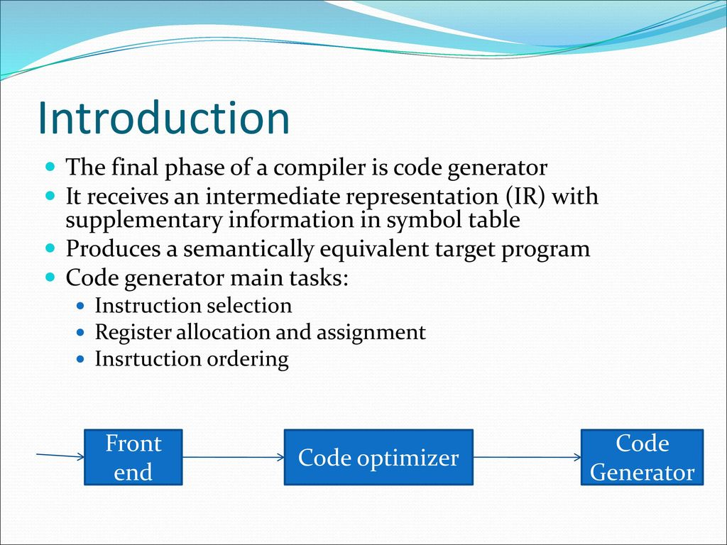

Slide 12
Directed Acyclic Graph (DAG)
How the intermediate code is transformed into target object code. The wayout is directed Acyclic graph.
Directed Acyclic Graph
Directed Acyclic Graph (DAG) is a tool that depicts the structure of basic blocks, helps to see the flow of values flowing among the basic blocks, and offers optimization too. DAG provides easy transformation on basic blocks. DAG can be understood here:
Leaf nodes represent identifiers, names or constants.
Interior nodes represent operators.
Interior nodes also represent the results of expressions or the identifiers/name where the values are to be stored or assigned.

Slide 13
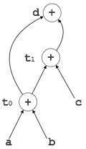
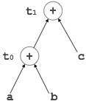

Example
Example:
t₀ = a + b
t₁ = t₀ + c
d = t₀ + t₁

Slide 14
Code Generator
A code generator is expected to have an understanding of the target machine’s runtime environment and its instruction set. The code generator should take the following things into consideration to generate the code:
Target language : The code generator has to be aware of the nature of the target language for which the code is to be transformed. That language may facilitate some machine-specific instructions to help the compiler generate the code in a more convenient way. The target machine can have either CISC or RISC processor architecture.
IR Type : Intermediate representation has various forms. It can be in Abstract Syntax Tree (AST) structure, Reverse Polish Notation, or 3-address code.
Selection of instruction : The code generator takes Intermediate Representation as input and converts (maps) it into target machine’s instruction set. One representation can have many ways (instructions) to convert it, so it becomes the responsibility of the code generator to choose the appropriate instructions wisely.
Register allocation : A program has a number of values to be maintained during the execution. The target machine’s architecture may not allow all of the values to be kept in the CPU memory or registers. Code generator decides what values to keep in the registers. Also, it decides the registers to be used to keep these values.
Ordering of instructions : At last, the code generator decides the order in which the instruction will be executed. It creates schedules for instructions to execute them.

Slide 15
Descriptors
The code generator has to track both the registers (for availability) and addresses (location of values) while generating the code. For both of them, the following two descriptors are used:
Register descriptor : Register descriptor is used to inform the code generator about the availability of registers. Register descriptor keeps track of values stored in each register. Whenever a new register is required during code generation, this descriptor is consulted for register availability.
Address descriptor : Values of the names (identifiers) used in the program might be stored at different locations while in execution. Address descriptors are used to keep track of memory locations where the values of identifiers are stored. These locations may include CPU registers, heaps, stacks, memory or a combination of the mentioned locations.

Slide 16
Code Generation
Basic blocks comprise of a sequence of three-address instructions. Code generator takes these sequence of instructions as input.
getReg : Code generator uses getReg function to determine the status of available registers and the location of name values. getReg works as follows:
If variable Y is already in register R, it uses that register.
Else if some register R is available, it uses that register.
Else if both the above options are not possible, it chooses a register that requires minimal number of load and store instructions.

Slide 17
Implementation of code generation
For an instruction x = y OP z, the code generator may perform the following actions.
Let us assume that L is the location (preferably register) where the output of y OP z is to be saved:
Call function getReg, to decide the location of L.
Determine the present location (register or memory) of y by consulting the Address Descriptor of y. If y is not presently in register L, then generate the following instruction to copy the value of y to L:
MOV y’, L
where y’ represents the copied value of y.

Slide 18
Implementation of code generation
Determine the present location of z using the same method used in step 2 for y and generate the following instruction:
OP z’, L
where z’ represents the copied value of z.
Now L contains the value of y OP z, that is intended to be assigned to x. So, if L is a register, update its descriptor to indicate that it contains the value of x. Update the descriptor of x to indicate that it is stored at location L.
If y and z has no further use, they can be given back to the system.

Slide 19
References
Department of computer Science
https://www.geeksforgeeks.org/intermediate-code-generation-in-compiler-design/
https://www.tutorialspoint.com/compiler_design/compiler_design_intermediate_code_generations.htm#:~:text=Intermediate%20code%20generator%20receives%20input,to%20be%20machine%20independent%20code.
https://www.javatpoint.com/intermediate-code

Slide 20
THANK YOU

